Slide 1
Chapter 16
Methodology
Conceptual Databases Design

Slide 2

Chapter 16 - Objectives
The purpose of a design methodology.
Database design has three main phases: conceptual, logical, and physical design.
How to decompose the scope of the design into specific views of the enterprise.

Slide 3
Chapter 16 – Objectives
How to use Entity–Relationship (ER) modeling to build a conceptual data model based on the data requirements of an enterprise.
How to validate the resultant conceptual model to ensure it is a true and accurate representation of the data requirements enterprise.

Slide 4
Chapter 16 - Objectives
How to document the process of conceptual database design.
End-users play an integral role throughout the process of conceptual database design.
Have them involved as much as possible!

Slide 5
Design Methodology
A structured approach that uses procedures, techniques, tools, and documentation aids to support and facilitate the process of design.

Slide 6

Database Design Methodology
Three main phases
  Conceptual database design (E-R diagrams)
  Logical database design (Tables)
  Physical database design

Slide 7
Conceptual Database Design
The process of constructing a model of the data used in an enterprise, independent of all physical considerations.

Slide 8
Logical Database Design
The process of constructing a model of the data used in an enterprise based on a specific data model (e.g. relational), but independent of a particular DBMS and other physical considerations.

Slide 9
Physical Database Design
The process of producing a description of the implementation of the database on secondary storage; it describes the base relations, file organizations, and indexes design used to achieve efficient access to the data, and any associated integrity constraints and security measures.

Slide 10
Critical Success Factors in Database Design
Work interactively with the users as much as possible.
Follow a structured methodology throughout the data modeling process.
Employ a data-driven approach.
Incorporate structural and integrity considerations into the data models.
Combine conceptualization, normalization, and transaction validation techniques into the data modeling methodology.

Slide 11
Critical Success Factors in Database Design
Use diagrams to represent as much of the data models as possible.
Use a Database Design Language (DBDL) to represent additional data semantics.
Build a data dictionary to supplement the data model diagrams.
Be willing to repeat steps.

Slide 12
Overview Database Design Methodology
Conceptual database design
Step 1 Build conceptual data model
  Step 1.1 Identify entity types
  Step 1.2 Identify relationship types
  Step 1.3 Identify and associate attributes with entity or relationship types
  Step 1.4 Determine attribute domains
  Step 1.5 Determine candidate, primary, and alternate key attributes

Slide 13
Overview Database Design Methodology
Step 1 Build conceptual data model (continue)
  Step 1.6 Consider use of enhanced modeling concepts (inheritance, aggregation, composition) (optional step)
  Step 1.7 Check model for redundancy
  Step 1.8 Validate conceptual model against user transactions
  Step 1.9 Review conceptual data model with user

Slide 14
Overview Database Design Methodology
Logical database design for the relational model
Step 2 Build and validate logical data model
  Step 2.1 Derive relations for logical data model
  Step 2.2 Validate relations using normalization
  Step 2.3 Validate relations against user transactions
  Step 2.4 Define integrity constraints

Slide 15
Overview Database Design Methodology
Step 2 Build and validate logical data model (continue)
  Step 2.5 Review logical data model with user
  Step 2.6 Merge logical data models into global model (optional step)
  Step 2.7 Check for future growth

Slide 16
Overview Database Design Methodology
Physical database design for relational database
Step 3 Translate logical data model for target DBMS
  Step 3.1 Design base relations
  Step 3.2 Design representation of derived data
  Step 3.3 Design general constraints

Slide 17
Overview Database Design Methodology
Step 4 Design indexes
  Step 4.1 Analyze transactions
  Step 4.3 Choose indexes
  Step 4.4 Estimate disk space requirements

Slide 18
Overview Database Design Methodology
Step 5 Design user views
Step 6 Design security mechanisms
Step 7 Consider the introduction of controlled redundancy
Step 8 Monitor and tune the operational system

Slide 19
Step 1 Build Conceptual Data
To build a conceptual data model of the data requirements of the enterprise.
  Model comprises entity types, relationship types, attributes and attribute domains, primary and alternate keys, and integrity constraints.
Step 1.1 Identify entity types
  To identify the required entity types.
Step 1.2 Identify relationship types
  To identify the important relationships that exist between the entity types.

Slide 20
Step 1 Build Conceptual Data
Step 1.3 Identify and associate attributes with entity or relationship types
  To associate attributes with the appropriate entity or relationship types and document the details of each attribute.
Step 1.4 Determine attribute domains
  To determine domains for the attributes in the data model and document the details of each domain.

Slide 21
Step 1 Build Conceptual Data
Step 1.5 Determine candidate, primary, and alternate key attributes
  To identify the candidate key(s) for each entity and if there is more than one candidate key, to choose one to be the primary key and the others as alternate keys.
Step 1.6 Consider use of enhanced modeling concepts (optional step)
  To consider the use of enhanced modeling concepts, such as specialization / generalization, aggregation, and composition.

Slide 22
Step 1 Build Conceptual Data Model
Step 1.7 Check model for redundancy
  To check for the presence of any redundancy in the model and to remove any that does exist.
Step 1.8 Validate conceptual model against user transactions
  To ensure that the conceptual model supports the required transactions.
Step1.9 Review conceptual data model with user
  To review the conceptual data model with the user to ensure that the model is a ‘true’ representation of the data requirements of the enterprise.

Slide 23
Can also have
peer walkthroughs
in any of these major steps

Slide 24
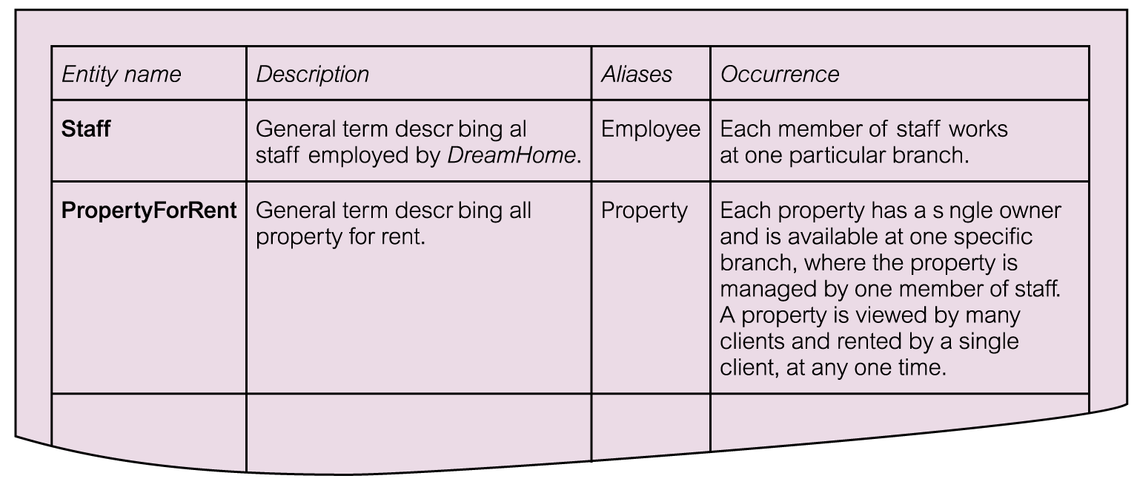
Extract from data dictionary for Staff user views of DreamHome showing description of entities

Slide 25
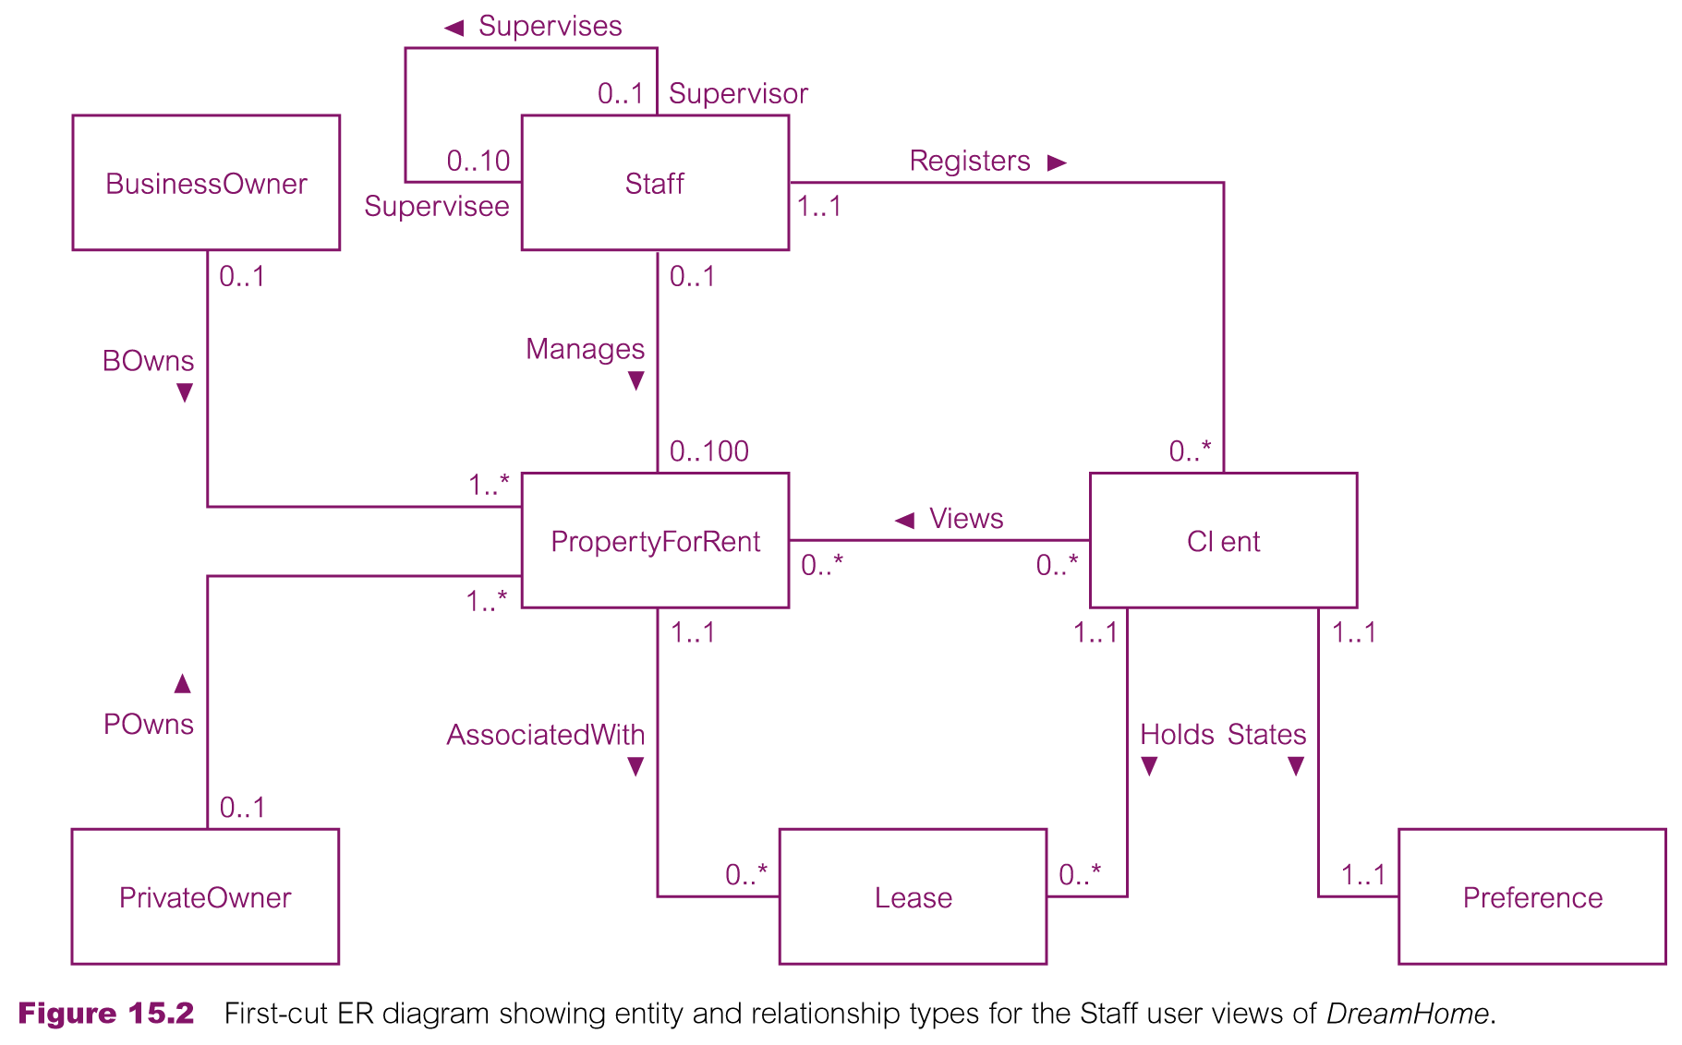
First-cut ER diagram for Staff user views of DreamHome

Slide 26
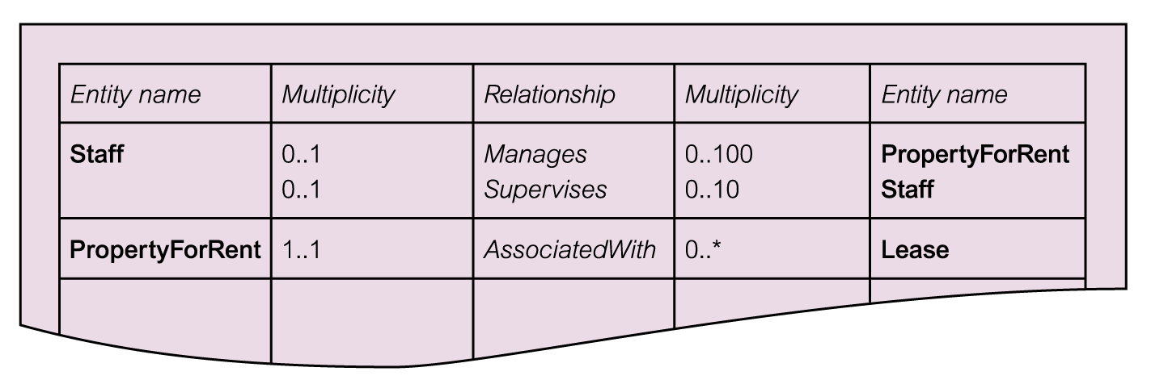
Extract from data dictionary for Staff user views of DreamHome showing description of relationships

Slide 27
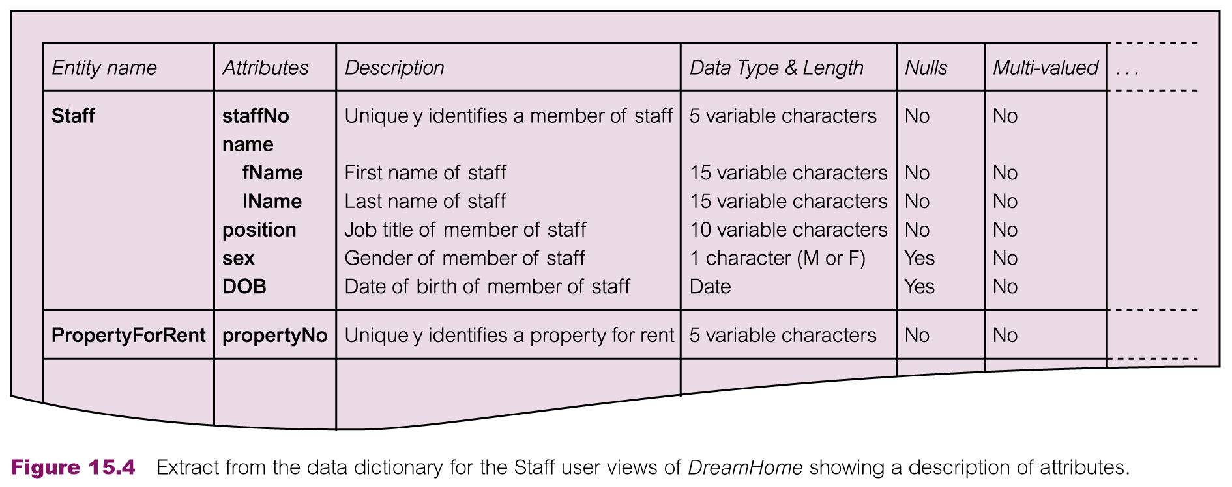
Extract from data dictionary for Staff user views of DreamHome showing description of attributes - Briefly.

Slide 28
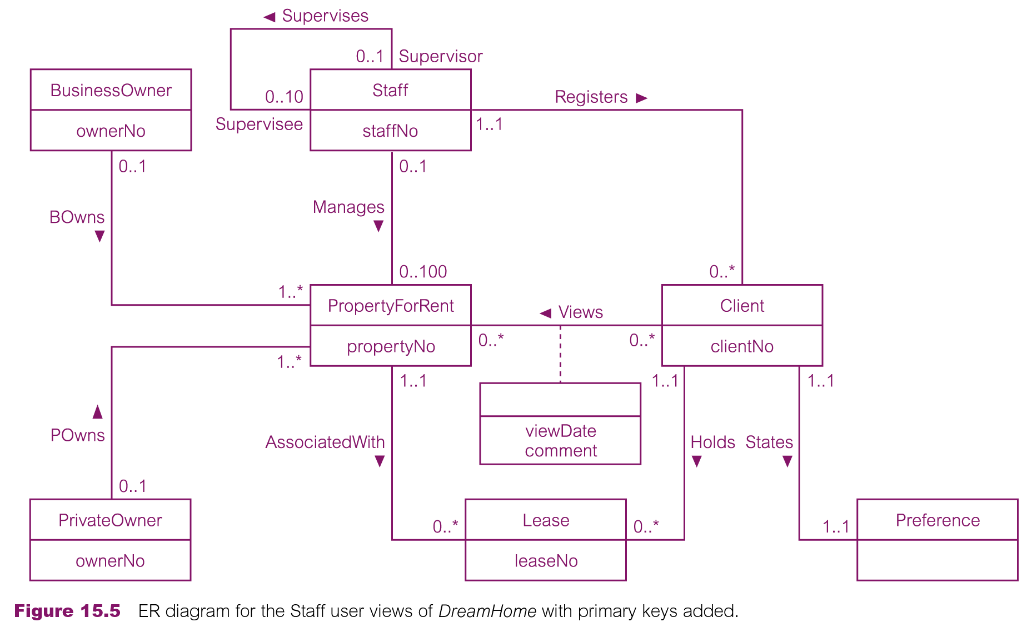
ER diagram for Staff user views of DreamHome with primary keys added

Slide 29
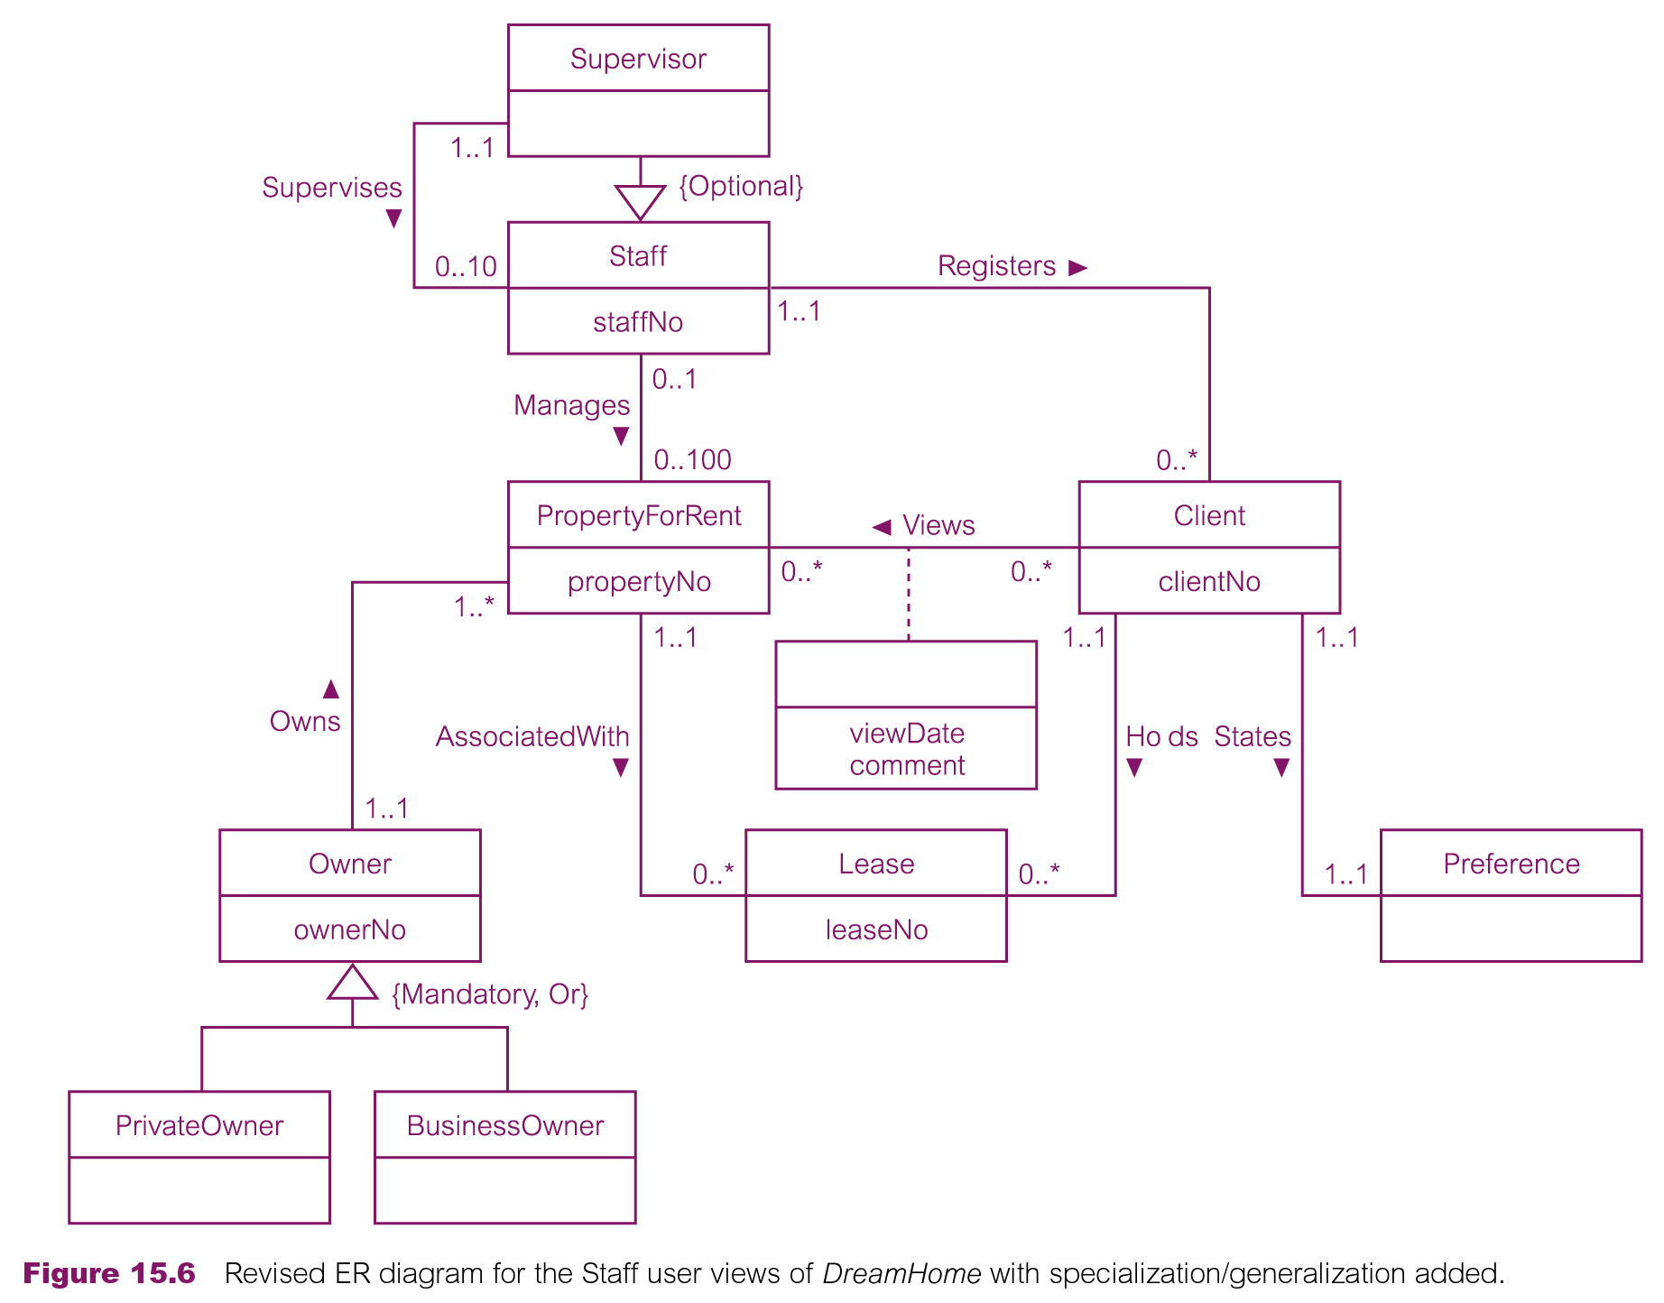
Revised ER diagram for Staff user views of DreamHome with specialization / generalization

Slide 30
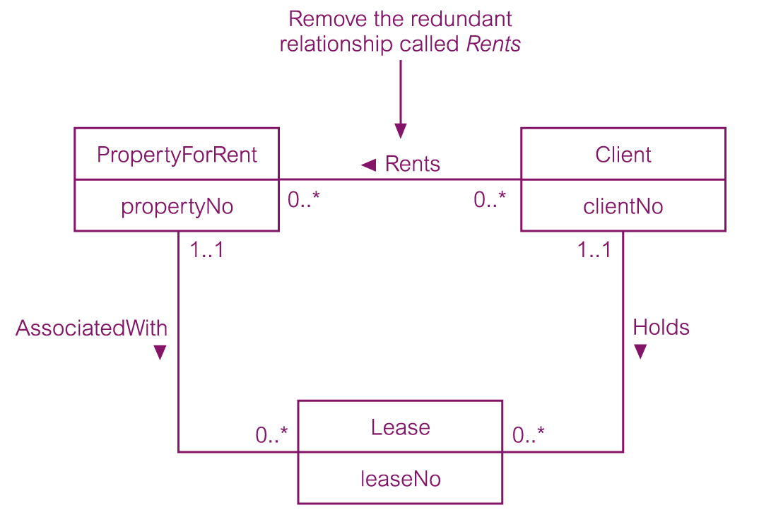
Example of removing a redundant relationship called Rents

Slide 31
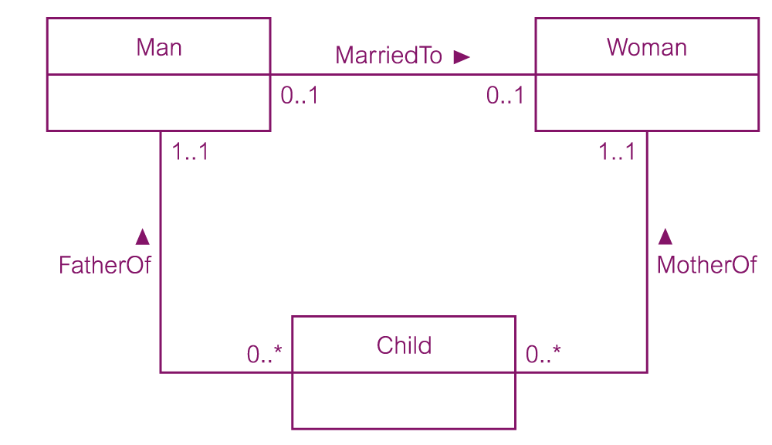
Example of a non-redundant relationship FatherOf - Optional

Slide 32
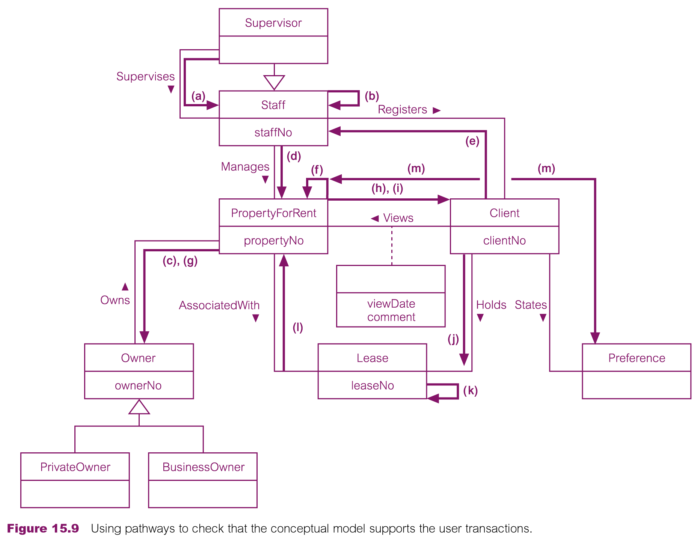
Using pathways to check that the conceptual model supports the user transactions - Briefly.

